Slide 1
Install R and Rstudio
***If R or RStudio is already installed on your laptop, please make sure the programs are CLOSED. Then, follow the steps below to install the required R version.
1) Download and install R version 4.1.1
Windows: https://cran.r-project.org/bin/windows/base/old/4.1.1/
Download and run the .exe file
Mac: https://cran.r-project.org/bin/macosx/base/
2) Download and install RStudio
Both Windows and Mac available here: https://posit.co/download/rstudio-desktop/
Skip the directions for installing R, go straight to installing RStudio
3) After installing, ensure both R and RStudio are closed.

Slide 2
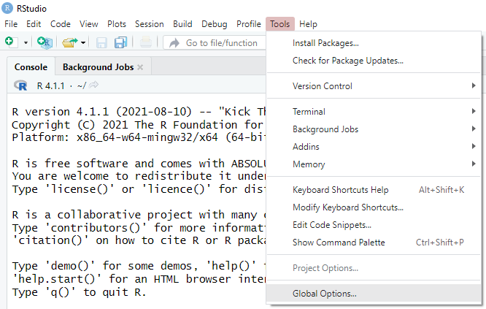
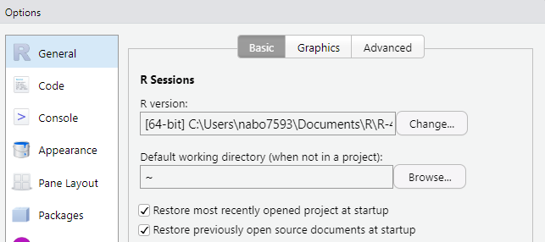
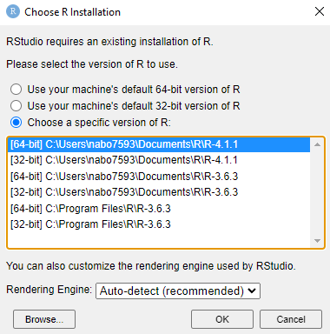
If another version of R is already installed on your laptop, ensure RStudio is running version 4.1.1 (skip this step if R was not previously installed on your laptop)
In Rstudio -> Tools -> Global Options -> General
In General, select ‘change’
Select version 4.1.1 or browse if necessary

Slide 3
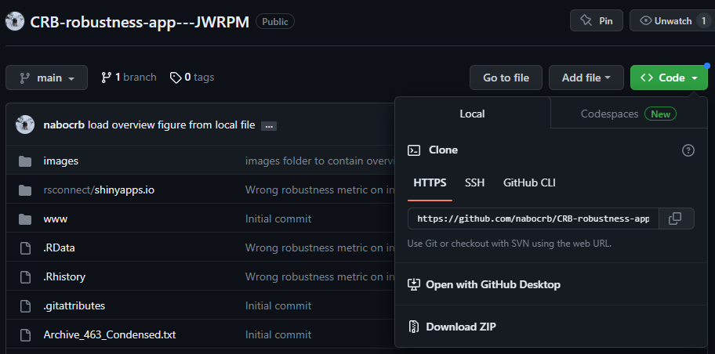
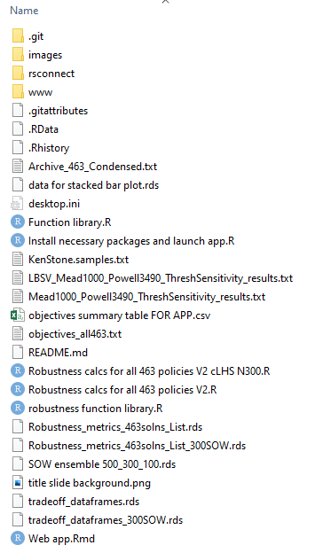
Download Robustness App from GitHub
Navigate to GitHub repository: https://github.com/nabocrb/CRB-robustness-app---JWRPM
Click on <> Code, select ‘Download ZIP’
Unzip the ZIP file to your preferred file directory. All files will be contained in a parent directory named ‘CRB robustness app – JWRPM’
CRB robustness app – JWRPM

Slide 4
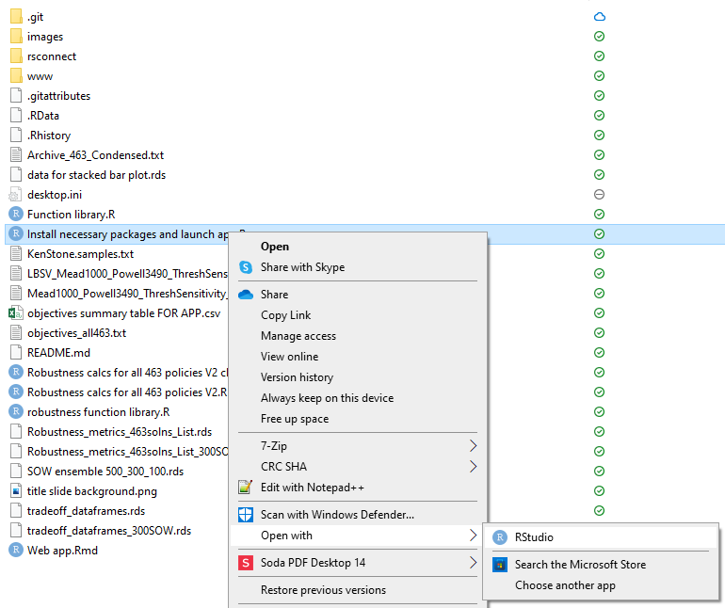
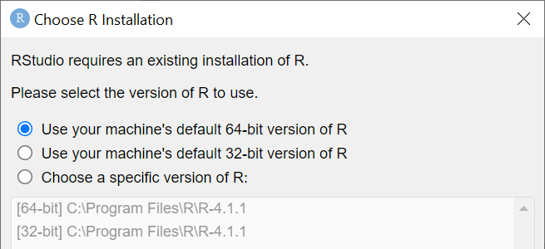
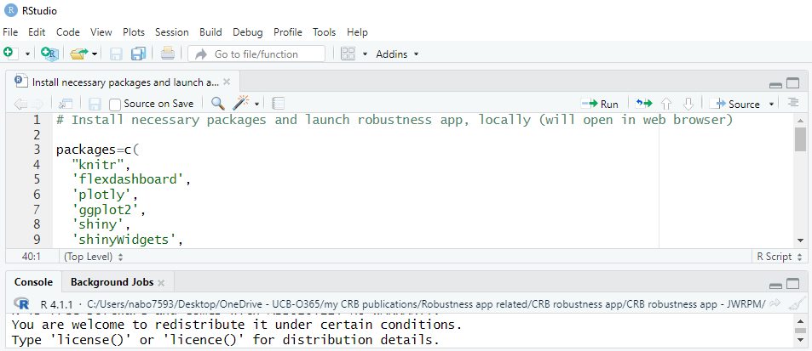
Run Robustness App
CRB robustness app – JWRPM
4) Right click ‘Install necessary packages and launch app.R’ and open in RStudio. If 'Open with' is not an option, double click on the file and select RStudio.
5) if asked which version of R to use, select the default
5) In RStudio, select ‘Source’. Necessary packages will be installed, then the app will automatically open in your default web browser
Working directory should default to ‘CRB robustness app – JWRPM’. If not, you will receive an error message after hitting Source. If this happens, raise your hand and ask for help!

Slide 5
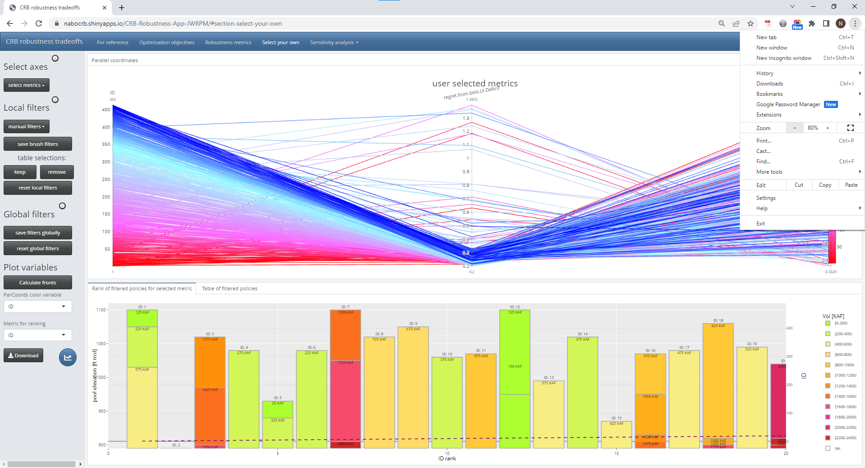
If the app appears ‘too large’ for your laptop screen, use your browser settings to change the zoom size to 70 - 90%

Slide 6
email nathan.bonham@colorado with any questions
If you are interested in adapting this app for another case study, please also feel free to reach out with questions.

